Slide 1
UNIT - 3.2
The UX Design Process

Slide 2
1. Information Architecture

Slide 3
What is Information Architecture?
▪
Information architecture (IA) is a science of organizing
and structuring content of the websites, web and mobile
applications, and social media software.
IA is a blueprint of the design structure which can be generated into wireframes and sitemaps of the project. UX designers use them as the basic materials so that they could plan navigation system.
According to the IAI experts, IA is the practice of deciding how to arrange the parts of something to be understandable.
▪
▪
▪

Slide 4
b) IA System Components
▪
If you want to build strong information architecture for
the product, you need to understand what it consists of.
Pioneers of the IA field, Lou Rosenfeld and Peter Moville
in their book “IA for the World Wide Web” have
distinguished four main components: organization systems, labeling systems, navigation systems and searching systems.
Organization systems
These are the groups or the categories in which the information is divided. Such system helps users to predict where they can find certain information easily.
There are three main organizational structures: Hierarchical, Sequential, and Matrix.
▪
1)
•
•

Slide 5
•
In addition, content can be grouped according to the
organization schemes. They are meant to categorize content the product. Here are some of the popular schemes:
Alphabetical schemes. Content is organized in alphabetical order. Also, they can serve as a navigation tool for the users.
Chronological schemes. This type organizes content by
date.
Topic schemes. Content is organized according to the specific subject.
Audience schemes. The type of content organization for
separate groups of users.
•
•
•
•

Slide 6
2) Labeling systems
3) Navigation systems
4) Searching systems

Slide 7
2. Interaction Design
▪ It is design of the interaction between users and products.
Most often when people talk about interaction design, the products tend to be software products like apps or websites.
▪ The goal of interaction design is to create products that enable the user to achieve their objective(s) in the best way possible.

Slide 8
The 5 dimensions of interaction design
1D: Words
▪ Words—especially those used in interactions, like button labels—should be meaningful and simple to understand. They should communicate information to users, but not too much information to overwhelm the user.
2D: Visual representations
▪ This concerns graphical elements like mages, typography and icons that users interact with. These usually supplement the words used to communicate information to users.
3D: Physical objects or space
▪ Through what physical objects do users interact with the product? A laptop, with a mouse or touchpad? Or a smartphone, with the user’s fingers?
4D:Time
▪ While this dimension sounds a little abstract, it mostly refers to media that changes with time (animation, videos, sounds).
5D:Behaviour
▪ This includes the mechanism of a product: how do users perform actions on the website? How do users operate the product?

Slide 9
3. Wireframes, Mockups,
Prototypes: Introduction

Slide 10
What is Wireframe?
▪
A wireframe is neither more nor less than a draft of the
product. When painting a picture, an artist firstly draws a sketch. It works the same way with mobile and web design.
Wireframe introduces a general scheme of the app or site and shows the layout of its components. It is usually the first step in the design process.
Wireframes may differ depending on the level of detalization. However, all of them reflect a basic view of app or site with a proper placement of buttons, tabs, icons, and other elements.
▪
▪

Slide 11
Why is wireframe needed?
▪ Wireframes help to organize data and clearly shows a content to be displayed on a certain app screen or website page.
▪ You might omit wireframing if you work on a very simple
and non-lasting project.
▪ If this is not the case, approach to the task with a great care. As a result, you will gain the following benefits:
– Clarity: since you will know for sure which elements are
going to be located on the defined screens or pages.
– Adjusting: since you can easily control the placement of elements, move or delete them if needed.
– Connection: since your client will be deeply involved in
the planning process.
– Protection: since you minimize the possibility to re-do the whole work from scratch.

Slide 12
Mockup
▪ You will get the following advantages:
– Specification : since your team receives a detailed description of the product.
– Understanding: since you see the product just the way the
users are going to see it.
– Perfection: since you can work through each minute detail.
– Confidence: since you know that you are headed in the right direction.

Slide 13
3. Prototyping Introduction

Slide 14
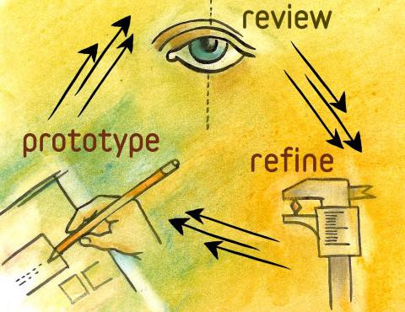
What is a Prototype, Exactly?
▪ “A simulation or sample version of a final product, which
is used for testing prior to launch.”
▪ The goal of a prototype is to test products (and product ideas) before sinking lots of time and money into the final product.

Slide 15
Prototypes have 4 main qualities:
•
Representation - form of the prototype, i.e.,
paper and mobile, or HTML and desktop.
Precision — The fidelity of the prototype, meaning its
level of detail, polish, and realism.
Interactivity — The functionality open to the user, e.g., fully functional, partially functional, or view-only
Evolution — The lifecycle of the prototype. Some are built quickly, tested, thrown away, and then replaced with an improved version (this is known as “rapid prototyping”). Others may be built and improved upon, ultimately evolving into the final product.
•
•
•

Slide 16
The Most Useful Prototyping Methodology
1)
Paper Prototyping
2)
Digital Prototyping
3) HTML Prototyping

Slide 17
4. Design Paradigm

Slide 18
4.1
4.2
4.3
Engineering Paradigm
Human Information Processing (HIP) Paradigm
Design-Thinking Paradigm

Slide 19
4. Design Thinking

Slide 20
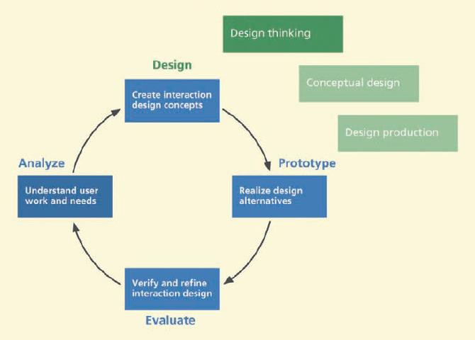

Slide 21
5. Design Perspectives
5.1
5.2
5.3
Ecological Perspective
Interaction Perspective
Emotional Perspective

Slide 22
6. User Persona

Slide 23
7. Ideation
Ideation is an active, fast-moving collaborative group
process for forming ideas for design.
It is an activity that goes with design thinking; you might say that ideation is a tool of design thinking; “ideation is applied design thinking”.
Ideation is where you start your conceptual design.

Slide 24
7. Sketching
▪ Sketching is the rapid creation of freehand drawings
expressing preliminary design ideas, focusing
rather than details.
on
concepts

Slide 25
8. Mental Models and Conceptual
Design
“A mental model is an explanation of someone’s thought
process about how something works in the real world.”
A conceptual design is the part of an interaction design
containing a theme, notion, or idea with the purpose
of
communicating a design vision about a system
product.”
or

Slide 26
